Slide 1
Chapter 3
Enhancing a Website with Links and Images

Slide 2
Chapter Objectives
You will have mastered the material in this chapter when you can:
Describe image file formats
Describe the image tag and its attributes
Add images to a website
Explain div elements and attributes
Use a div element within a webpage

Slide 3
Chapter Objectives (continued)
Describe types of hyperlinks
Create relative links, absolute links, bookmark links, email links, and telephone links
Describe the types of lists in an HTML document
Create an unordered list and a description list
Embed a map within a webpage
Test and validate links on a webpage

Slide 4
Introduction
Almost all modern webpages contain images
Images are used throughout a website to enhance visual appeal and provide visitors with additional information about a product or service
Other images, such as a business logo, promote the company’s presence and brand

Slide 5
Project — Add Images and Links to a Website
Most websites use images to enhance the look and feel of their webpages
Roadmap
ADD IMAGES to a template and to webpages
ADD DIV ELEMENTS to a template and to webpages
ADD HYPERLINKS to a template and to webpages
ADD LISTS to a webpage
EMBED a MAP on a webpage
VIEW the WEBSITE IN a BROWSER AND TEST the webpage LINKS
VALIDATE the new PAGES

Slide 6
Adding Images to a Website
Images include photos, drawings, diagrams, charts, and other graphics that convey visual information
Help break up text and contribute to the design and aesthetics of a website
Support the purpose of the webpage or illustrate the content

Slide 7
Image File Formats
Image files are created in several formats
Graphics Interchange Format (GIF) supports transparency and frame animation
Lossless compression: compresses an image; GIF uses this technique to maintain the file’s color information
Portable Network Graphics (PNG) supports transparency, but not animation

Slide 8
Image File Formats (continued 1)
Joint Photographic Experts Group (JPG or JPEG) is a standard file format for digital photos
Lossy compression: used to reduce file size; this technique is used to discard some of the color information in the image
Scalable Vector Graphics (SVG) is a format that uses markup language to create two-dimensional graphics, images, and animations

Slide 9
Image File Formats (continued 2)
Format | Pros | Cons | Use for
GIF | Small file size; supports transparency and animation | Limited to 256 colors | Line drawings and animations
PNG | Small file size; supports transparency and more than a million colors | Does not support animation | Images that are not digital photos
JPG | Supports more than a million colors | Larger file size | Digital photos
SVG | Flexible; scalable; no files needed because graphics are created with code | Not supported by older browsers and not all modern browsers support all SVG features | Shapes, lines, text, and gradients
Table 3–1 Choosing an Image File Format

Slide 10
Image Dimensions and File Size
Pixel: smallest element of light or color on a device displaying images
Common resolution for laptops is 1366 x 768 pixels
The disadvantage of an image with a high resolution is that it also has a large file size
Use graphic or photo editors to optimize an image with a large file size to reduce its file size and load time

Slide 11
Image File Names
When using images within a website, be sure to give each image file a meaningful file name
Most digital cameras use a default file-naming convention, such as IMG001.jpg, which does not describe the image in the photo

Slide 12
Image Tag and Its Attributes
The image tag is an empty HTML tag used to add an image to a webpage
<img>
The image tag includes several attributes
src
alt
height
width

Slide 13
Image Tag and Its Attributes (continued 1)
Attribute | Function
src | Identifies the file name of the image to display
alt | Specifies alternate text to display when an image is being loaded Especially useful for screen readers, which translate information on a computer screen into audio output Should briefly describe the purpose of the image in 125 characters or less
height | Defines the height of the image in pixels, which improves loading time
width | Defines the width of the image in pixels, which improves loading time
Table 3–2 Image Element Attributes

Slide 14
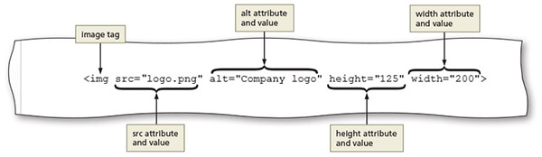
Image Tag and Its Attributes (continued 2)
Figure 3–12
Notes:
The

Slide 15
Exploring Div Elements
Div element defines an area or a division in a webpage
Uses the <div> and </div> tags
Used to structure parts of a webpage to which an HTML 5 element does not apply
Can be used within the main element to further divide the primary content area into separate sections

Slide 16
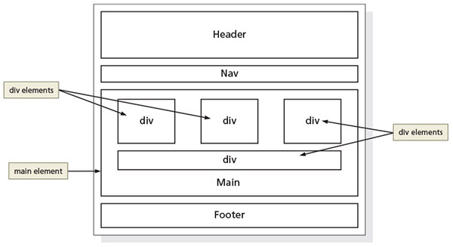
Exploring Div Elements (continued)
Figure 3–21

Slide 17
Div Attributes
Div elements have attributes that provide information about the element
The id div attribute identifies a unique area on a webpage and distinguishes it from other page divisions

Slide 18
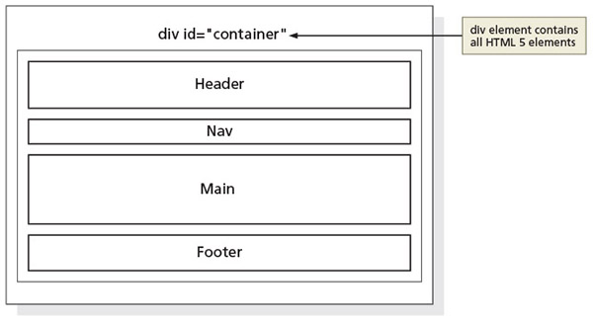
Div Attributes (continued)
Figure 3–23

Slide 19
Adding Links to a Webpage
Hyperlink: link on a webpage that allows users to navigate a website and move from one page to another
Link: text, an image, or other webpage content that visitors tap or click to instruct the browser to go to a location in a file
Text link: when text is coded as a hyperlink, it appears as underlined text in a color different from the rest of the webpage text
Image link: an image used as a link; some websites display a border around the image

Slide 20
Anchor Element
Used to create a hyperlink on a webpage
The <a> and </a> are the start and the end tags
Include the href attribute in the starting anchor tag to identify the webpage, email address, file, telephone number, or other content to access
The value of the href attribute is the content for a link

Slide 21
Relative Links
Hyperlink that links to other webpages within the same website
Created by using an anchor tag with an href attribute that designates the file name of the webpage or the path and the file name of the webpage

Slide 22
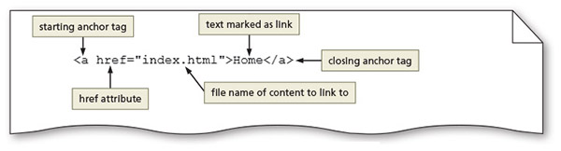
Relative Links (continued)
Figure 3–30

Slide 23
Absolute Links
Hyperlink that links to other webpages outside of a website
Created using an anchor element with an href attribute that designates a website URL

Slide 24
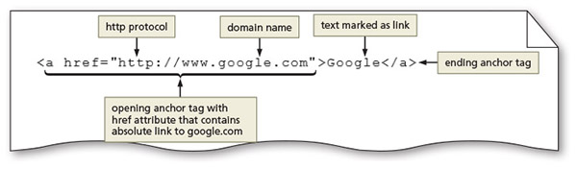
Absolute Links (continued)
Figure 3–31

Slide 25
Bookmarks
Some webpages contain a lot of content, making the page quite long
Requires excessive scrolling to see all the page content
Bookmarks let website visitors jump to specific areas on the page
To create a bookmark, insert an id attribute and value in the element where you want to include a bookmark
Next, create a link to the bookmark

Slide 26
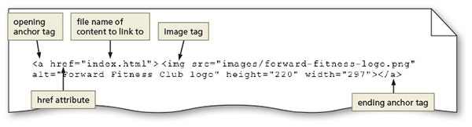
Image Links
Images can be used to link to another page within the site, another website, an email address, or a telephone number
Figure 3–32

Slide 27
Email Links
Hyperlink that links to an email address
Use anchor elements to link to an email address by including the href attribute followed by "mailto:" and then the email address

Slide 28
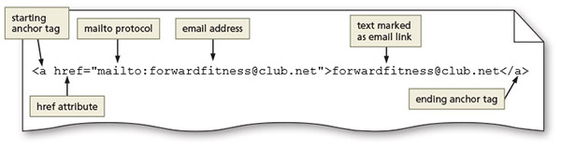
Email Links (continued)
Figure 3–33

Slide 29
Telephone Links
Hyperlink that links to a telephone number
Use an anchor element to link to a telephone number by including the href attribute, followed by "tel:+1number" where +1 is the international dialing prefix and number is the phone number

Slide 30
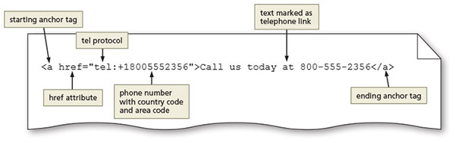
Telephone Links (continued)
Figure 3–35

Slide 31
Adding Lists
Lists structure text into an itemized format
Unordered lists display bulleted items in any sequence
The <ul> and </ul> are the start and end tags for an unordered list
<li> and </li> are the start and end list item tags
The following code creates a bulleted list of two items:
<ul>
<li>First item</li>
<li>Second item</li>
</ul>

Slide 32
Adding Lists (continued 1)
Ordered lists display information in a series using numbers or letters
The <ol> and </ol> are the start and end tags for an ordered list
<li> and </li> are the start and end list item tags
The following code creates a numbered list of two items:
<ol>
<li>First item</li>
<li>Second item</li>
</ol>

Slide 33
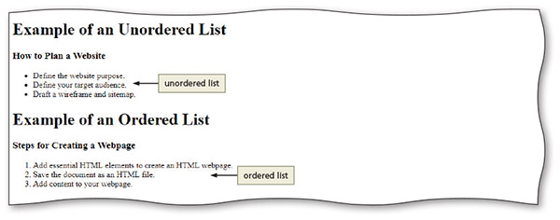
Adding Lists (continued 2)
Figure 3–51

Slide 34
Adding Lists (continued 3)
A description list contains terms and descriptions
The <dl> and </dl> are the start and end tags for a description list
Each term is marked within a pair of <dt> and </dt> tags
Each description or definition is marked between a pair of <dd> and </dd> tags

Slide 35
Adding Lists (continued 4)
The following code creates a description list of two terms and definitions:
<dl>
<dt>First term</dt>
<dd>First definition</dd>
<dt>Second term</dt>
<dd>Second definition – part 1</dd>
<dd>Second definition – part 2</dd>
</dl>

Slide 36
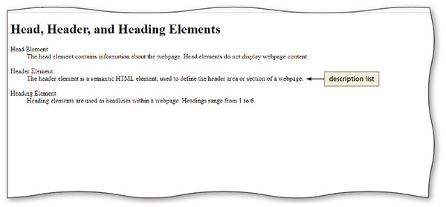
Adding Lists (continued 5)
Figure 3–52

Slide 37
Embedding a Map
Many businesses include a location map embedded within their website
Gives visitors a clear view of the business location
Websites such as maps.google.com and mapquest.com provide online maps
Web developers can visit an online map, enter an address, and then obtain the required code to embed the online map directly within a webpage

Slide 38
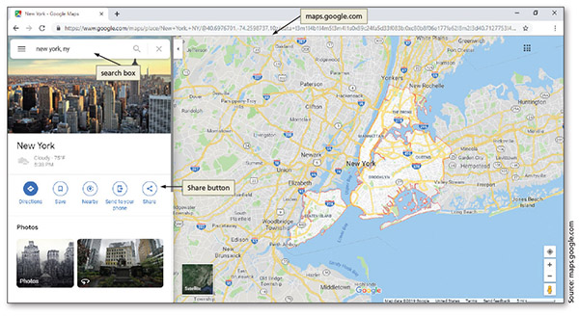
Embedding a Map (continued 1)
Figure 3–67

Slide 39
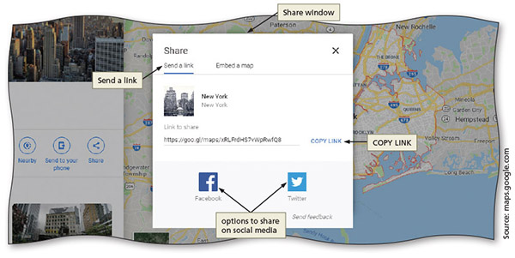
Embedding a Map (continued 2)
Figure 3–68

Slide 40
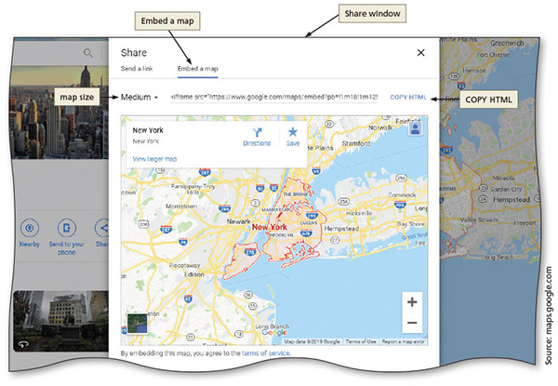
Embedding a Map (continued 3)
Figure 3–69

Slide 41
Chapter Summary
In this chapter, you learned about:
Creating many types of hyperlinks
Inserting new HTML elements, including div elements, image elements, headings, and lists

